Slide 1
function Vs method
Author : Abdelrahman Abdelmoez

Slide 2
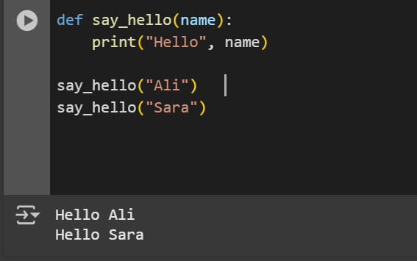
Function :
A function is a set of programming instructions (code) that we put inside a single block, and we can call it at any time to execute this code.

Slide 3
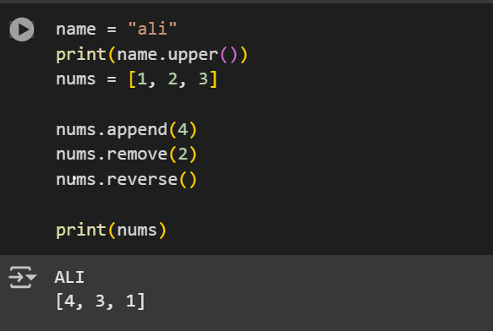
Method
A method is a special type of function, but it is associated with a specific object, such as a list, string, or dict.

Slide 4
Comparison
Function
Method
A function is an independent thing
Call by name
The function is not method
Connecting with object
Call by object.Method
The method is function

Slide 5
Thanks Any Question ?

